Slide 1
SBOM Sprint #3
Thomas Eby, Pranav Gonepalli, Evan Hellersund, Manel Leong,
Camron Rule, Skyler Walker, Duohan Xu, Rachel Zheng
College of William & Mary
CSCI 435: Software Engineering
October 23, 2024

Slide 2
Sprint Goal
Implement SBOM parsing and tree visualization for SPDX 2.2 standard

Slide 3
Sprint Backlog - Front end
Set up initial tree
Set up sidebar in initial visualization page
Add ability to expand/collapse tree
Connect tree to backend interface

Slide 4
Sprint Backlog - Backend
Created mock tree data for visualization in the frontend
Made SBOM component id to data map
Made significant progress towards building the relationship tree from the SBOM

Slide 5
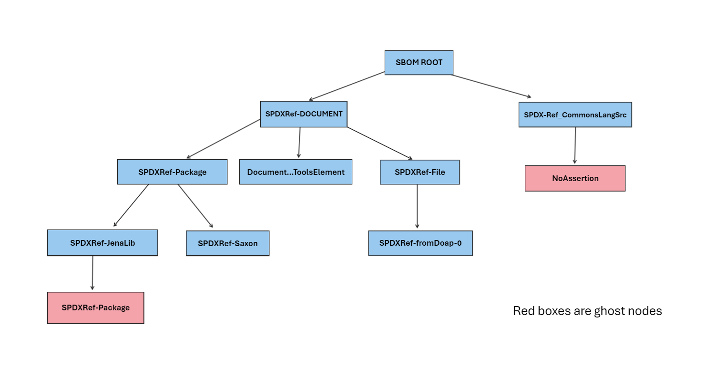
Sprint Backlog - Backend

Slide 6
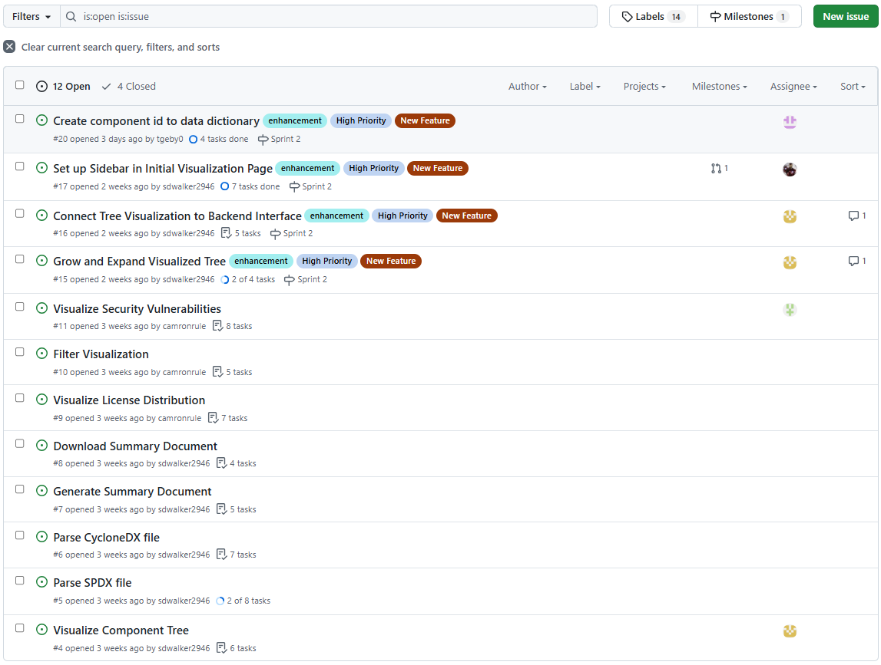
Issue Tracker

Slide 7
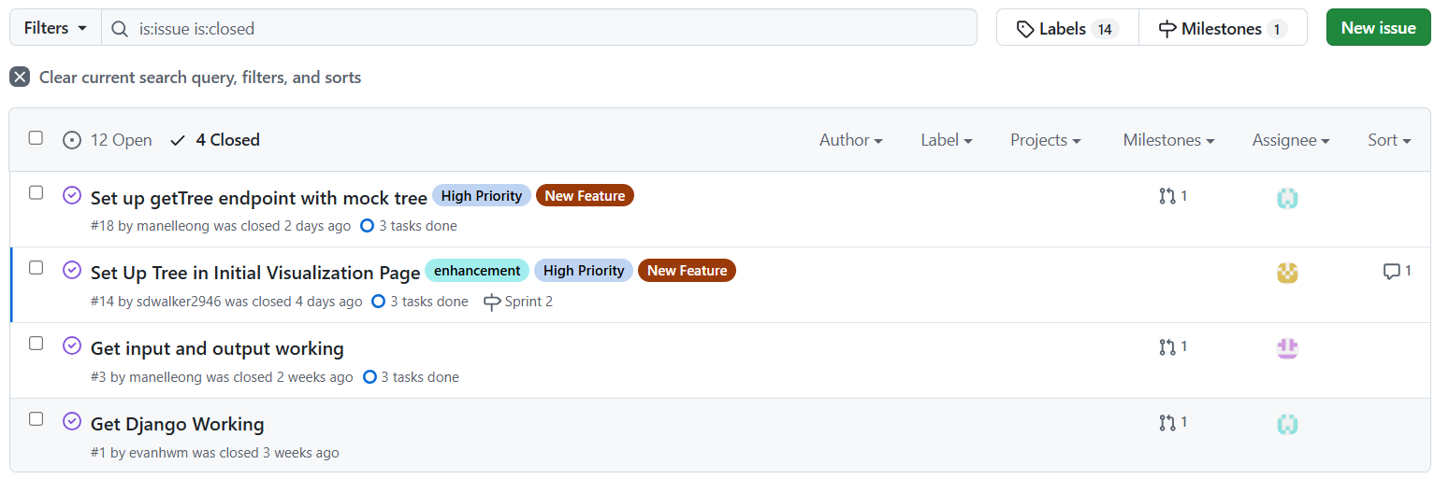
Issue Tracker (Continued)

Slide 8
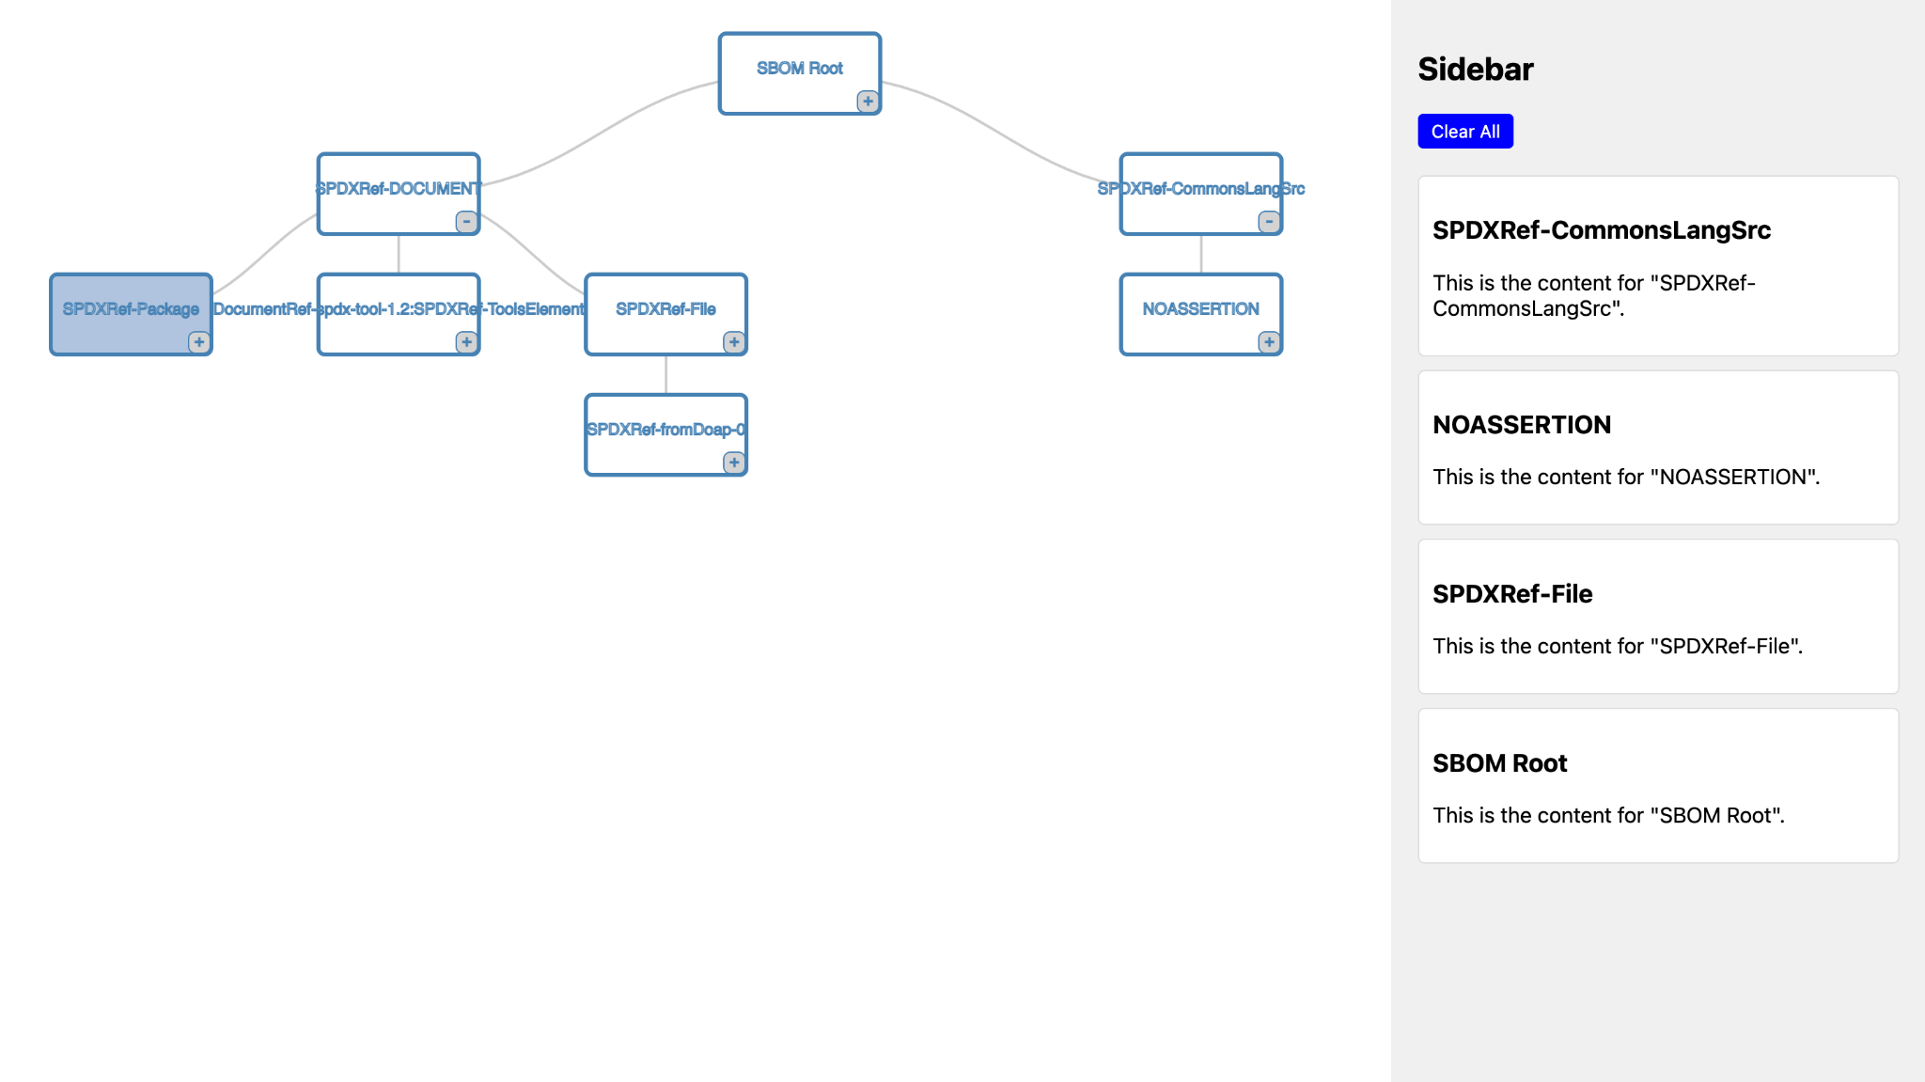
Tree Visualization Page

Slide 9
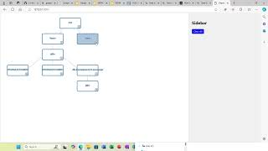
Demo

Slide 10
Scanning for Security Vulnerabilities
Decided to use github repository bomber to scan for security vulnerabilities
Bomber takes as input a sbom file and can output a json file of the security vulnerabilities it found
Some issues and thoughts:
Doesn’t return the exact cvss score but rather the level of severity
Shows the purl and related vulnerabilities but doesn’t connect back to the specific sbom component (working on solution)
Which cvss score to use?
Bomber is not entirely comprehensive
Do we want to add other info? (ie. related cwe, links to resources, version number affected, etc)

Slide 11
Bomber (osv version) only identifies vulnerabilities from these ecosystems:
AlmaLinux
Alpine
Android
Bitnami
crates.io
Curl
Debian GNU/Linux
Git (including C/C++)
GitHub Actions
Go
Haskell
Hex
Linux kernel
Maven
npm
NuGet
OSS-Fuzz
Packagist
Pub
PyPI
Python
R (CRAN and Bioconductor)
Rocky Linux
RubyGems
SwiftURL
Ubuntu OS

Slide 12
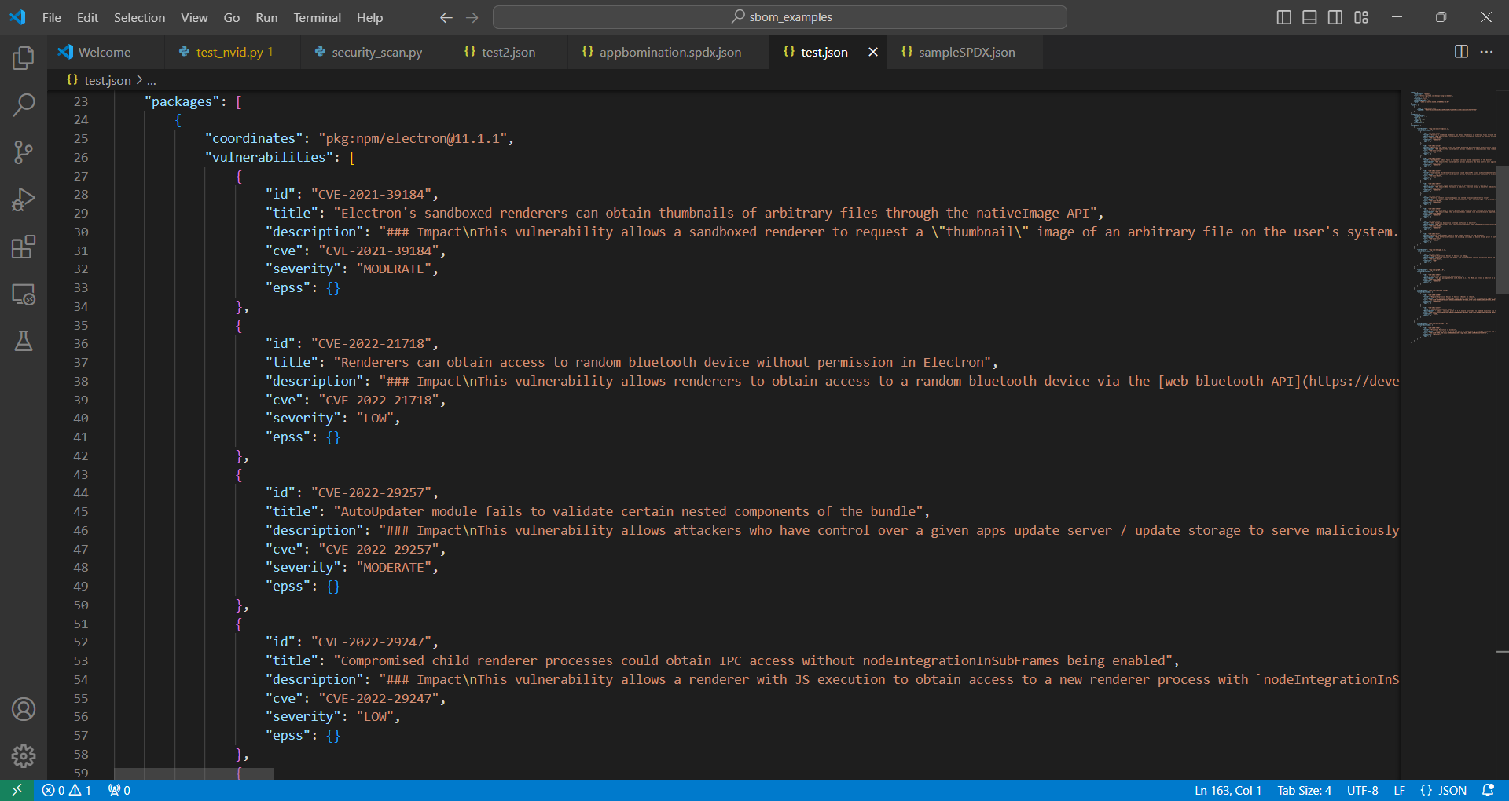
Bomber output example

Slide 13
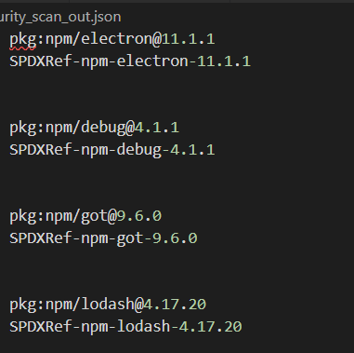
Finding the corresponding spdx id

Slide 14
Next Sprint Backlog
Generate summary document
Create universal header for navigation to different pages
Visualize license distribution
Parse SBOMs ourselves
Implement session-based storage of SBOM information

Slide 15
Lessons
Improve communication between front-end and back-end so that expectations for tree visualization are agreed upon
We need to work earlier in the week so our branches can be merged before the sprint review
Additionally, too many branches leads to confusion between team members
The lib4sbom parser omits some information, so we will need to implement parsing ourselves

Slide 16
Contributions
Manel: Set up getTree endpoint and filled it with mock tree data
Skyler: With Camron, implemented and debugged the tree visualization. Connected frontend and backend. Also created issues, labels, and milestones.
Thomas: Developed an algorithm to build a relationship tree based on the lib4sbom parser interface. Set up endpoint for retrieving the sbom id to data dictionary.
Pranav: Implemented sidebar and combined with tree visualization page, ensuring functionality worked between the two.
Camron: Styled main page. Implemented and took part in modifying an existing D3 tree for our purposes.
Rachel: Worked on identifying security vulnerabilities given a sbom file
Evan: Worked on looking for existing tools that could be adapted and researched licensing
Duohan: Discussed over the tree structure in the backend. Not making much progress due to time conflicts
Everyone: Worked on slides and performed research

